Slide 1

Genomic Analysis on Schizophrenia
Richard Clarke
Doron lisiansky
Leon Kwan
Group 5

Slide 2
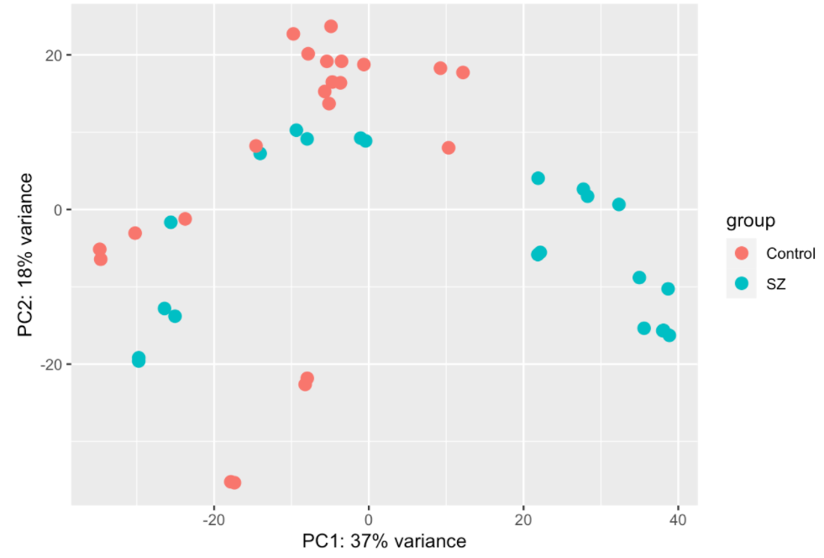
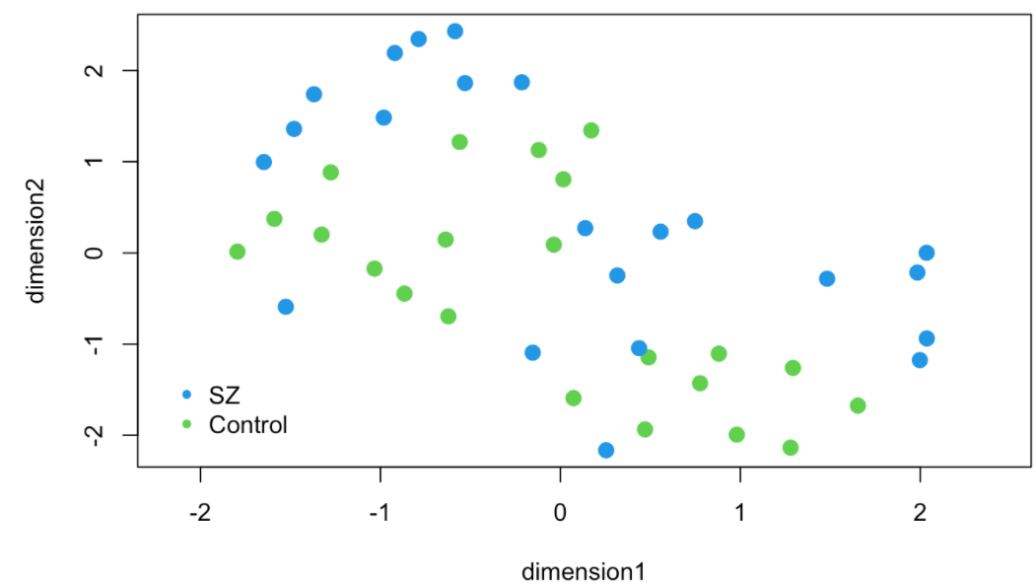
Introduction
Our approach is to analyze the results of the different analysis methods between two main groups: patients with Schizophrenia and without.
The data we selected contains 44 samples with 26,364 different genes of RNA-sequencing data.
Some genes have high expression ranges but most of the genes are not as variable
We performed unsupervised clustering methods to check the difference between all samples and compared it to the real division to check which cells are making the difference and which cells we should focus while developing new drugs .
We have performed differential analysis on the samples from our two groups, we extracted a list of significantly differentially expressed genes to reduce the data and ran 3 enrichment analysis
Notes:
ricky

Slide 3
Hypothesis
Scientific Question: Using RNA-sequencing data from a drug screening of neural progenitor cells from individuals with schizophrenia, which drugs will be more effective?
This is why We want to identify those drugs that reverse post-mortem SZ associated transcriptomic signatures, also identify the differentially regulate neuropsychiatric disease associated genes in a cell type (hiPSC NPC vs. CCL) and a diagnosis (SZ vs. control)-dependent manner.

Slide 4
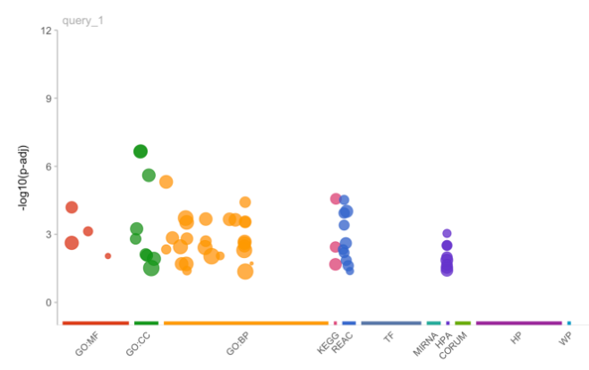
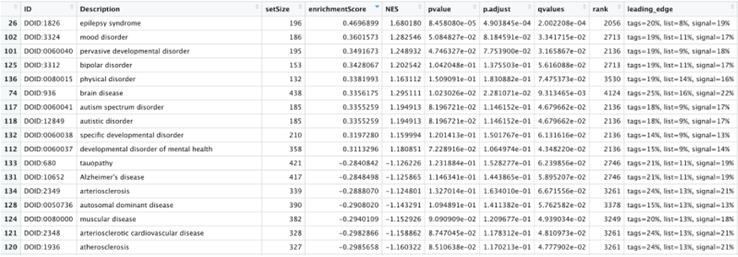
Differential Expression and Enrichment Analysis
we have performed differential analysis on the samples from the two groups, we extracted a list of significantly differentially expressed genes and run 3 enrichment analysis:
method :gprofiler2 Ontology : Gene Ontology
Method :clustProfiler Ontology : Disease Ontology
Notes:
ricky/ doron

Slide 5
Differential Expression and Enrichment Analysis
Differential analysis results
The top 2 genes - GPR12, SLC6A11 - are both brain related.
GPR12 is involved in neural development and neuropathic pain [1].
SLC6A11 encodes a GABA neurotransmission inhibitor
Enrichment Analysis results.
The clearest results came from clustProfiler’s GO. The top results were all genes related to the synapse (in order of significance): glutamatergic synapse, neuron to neuron synapse, asymmetric synapse, and Postsynaptic density
A decrease in Postsynaptic density has also been shown in SZ patients’ post-mortem tissue [2].
[1] Allende, Gonzalo et al. “Advances in Neurobiology and Pharmacology of GPR12.” Frontiers in pharmacology vol. 11 628. 8 May. 2020, doi:10.3389/fphar.2020.00628
[2] Amber Berdenis van Berlekom, Cita H Muflihah, Gijsje J L J Snijders, Harold D MacGillavry, Jinte Middeldorp, Elly M Hol, René S Kahn, Lot D de Witte, Synapse Pathology in Schizophrenia: A Meta-analysis of Postsynaptic Elements in Postmortem Brain Studies, Schizophrenia Bulletin, Volume 46, Issue 2, March 2020, Pages 374–386, https://doi.org/10.1093/schbul/sbz060

Slide 6
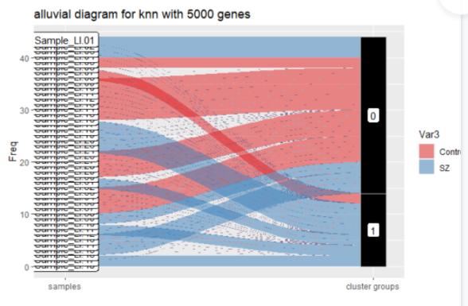
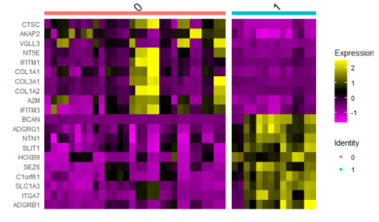
Clustering & Enrichment Analysis - knn clustring
Heatmap for top 20 variable genes
we got 2 classes and from the alluvial plot we can see the clustering was very good in compare to the real groups(sz, control)
for the knn clustering we used Seurat library which clusters the cells based on their PCA scores
To decide how many components should we choose to include, we applied the Elbow plot method: a ranking of principle components based on the percentage of variance explained by each one
in knn method we are not selecting k, instead we are Setting the resolution parameter is changing the number of clusters
Notes:
doron

Slide 7
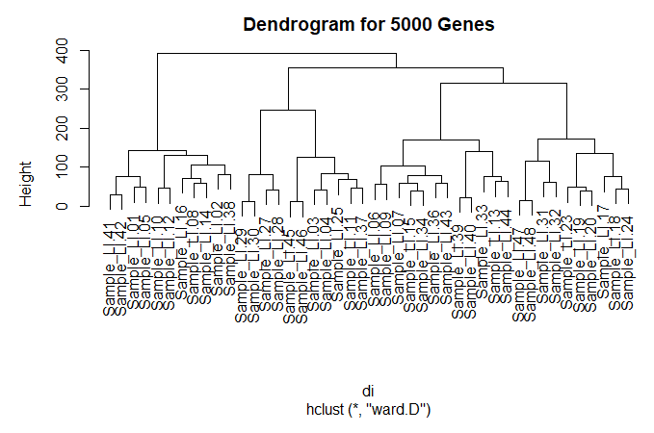
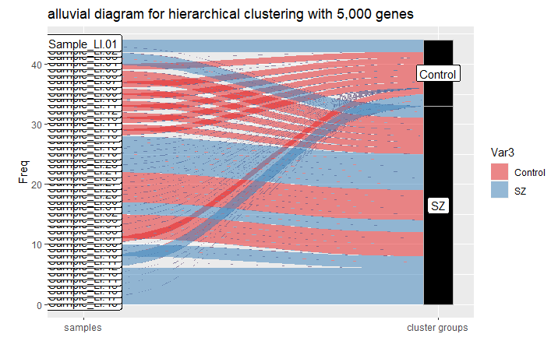
Clustering & Enrichment Analysis - Hierarchical Clustering
Selected top 10, 100, 1000, 5000, and 10000 most variable genes
Created a normalized distance matrix to reflect accurate data with distance function
Ran hclust method with the required parameters to produce the dendrogram
Selected different K values until clusters matched best with control and SZ groups
Ended up with K = 2
Use cutree function to create the clusters from a given K value
Notes:
ricky

Slide 8
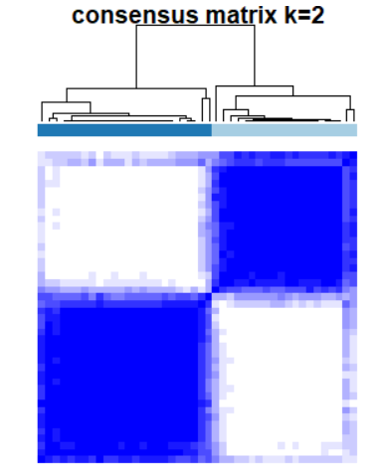
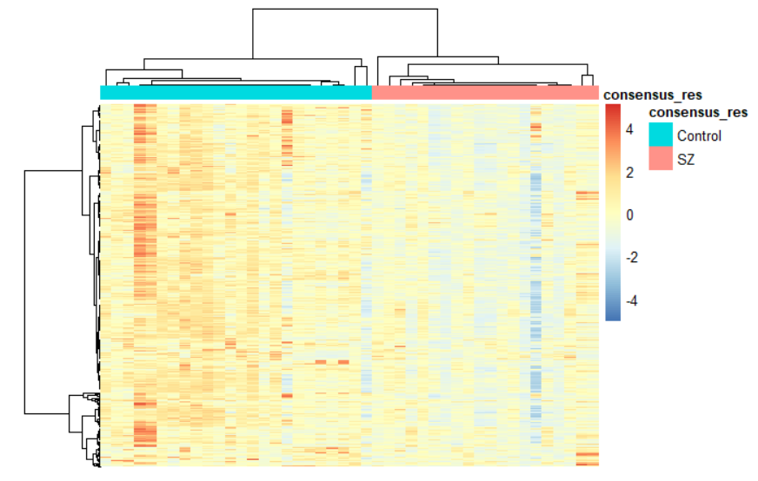
Clustering: Clustering Consensus with PAM
Found that 2 clusters was the best fit, aligning with the provided data.
Heatmap shows the differences in gene expression between control and schizophrenic patients.

Slide 9
Clustering Results
 | KNN_results | consensus_results | hclust_results
chisq value | 8.48571429 | 0.09166667 | 0.4848485
Original P value | 0.00357946 | 0.76206893 | 0.4862343
Adjusted P Value | 0.01073838 | 0.76206893 | 0.7293515
Consensus Clustering with PAM and hierarchical clustering fit the data, and KNN did not
From the results, the consensus clustering with PAM algorithm and hierarchical clustering algorithm were able to group had high p-values, meaning they were not statistically different than the sample label.
The KNN algorithm clustered the data significantly different than the sample with a p-value < 0.05
Notes:
ricky

Slide 10
Conclusion
Using enrichment analysis and unsupervised clustering on patients with and without schizophrenia, we identified specific genes that could be future targets for drugs. These included genes such as GPR12, SLC6A11.
Methods used to identify genes are hierarchical clustering and consensus clustering with PAM.
Notes:
doron

Slide 11
Future Work
Currently our division into groups in all analysis methods focuses on sz vs control but as we saw in the intro there is also a division into drugs, if we had more time we would try to focus more on the difference of the drugs given to patients and thus get different results for different drug types and cells.
We would basically look for which drugs are similar in nature using pca or other analysis to reduce the number of different drugs and then repeat the steps from assignments 2 and 3 to perform an extended analysis on the groups obtained.
New Scientific Question: Using RNA-sequencing data from a drug screening of neural progenitor cells from individuals with schizophrenia, from the drugs we found to be more effective , do they affect and show the same treatment results for all patients, or there is difference due to ethnicity/age/gender?
Notes:
doron

